Slide 1

Objectives
In this session, you will learn to:
  Appreciate the need for denormalization

Slide 2
Understanding Denormalization
Sometimes, you have to join multiple tables to get a simple output.
This affects the performance of a query.
In such cases, a degree of redundancy is introduced either by adding extra columns or extra tables.
Notes:
You can summarize the session by running through the summary given in SG.
In addition, you can also ask students summarize what they have learnt in this session.

Slide 3
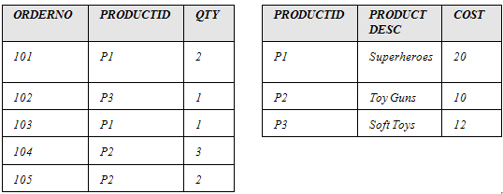
Definition of Denormalization
The intentional introduction of redundancy in a table in order to improve performance is called denormalization.
Consider the tables, ORDERS and PRODUCTS, as shown in the following diagram.
Notes:
You can summarize the session by running through the summary given in SG.
In addition, you can also ask students summarize what they have learnt in this session.

Slide 4
Definition of Denormalization (Contd.)
If a shopkeeper wants to calculate the total sales of his shop, he can use the following query:
  SELECT SUM((cost*qty)+(0.10*cost*qty))
  FROM Orders JOIN Products
  ON Orders.ProductId = Products.ProductId
There is a join and computation involved in the preceding query.
Therefore, if there are thousands of rows, the server will take a lot of time to process the query and return the result.
Notes:
You can summarize the session by running through the summary given in SG.
In addition, you can also ask students summarize what they have learnt in this session.

Slide 5
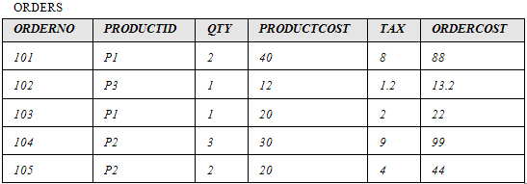
Definition of Denormalization (Contd.)
To speed up the processing of the query, store the cost of each order along with the tax, as shown in the following diagram.
Notes:
You can summarize the session by running through the summary given in SG.
In addition, you can also ask students summarize what they have learnt in this session.

Slide 6
Definition of Denormalization (Contd.)
To find out the total sales made, you can now issue the following query:
SELECT SUM (OrderCost) FROM Orders
The decision to denormalize will result in a compromise between performance and data consistency.
Denormalization also increases disk space utilization.
Notes:
You can summarize the session by running through the summary given in SG.
In addition, you can also ask students summarize what they have learnt in this session.

Slide 7
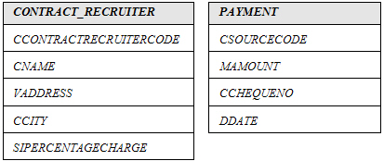
Just a minute
In the reporting system, the total amount paid to a contract recruiter is often required. The required result can be calculated using the following two tables.
    Since the size of the PAYMENT table is large, the join between the two tables takes time to generate the required output. It is, therefore, necessary to improve the performance of this query.
Notes:
You can summarize the session by running through the summary given in SG.
In addition, you can also ask students summarize what they have learnt in this session.

Slide 8
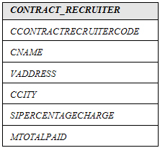
Just a minute (Contd.)
Solution:
  Denormalize the tables. Add a column called MTOTALPAID to the following CONTRACT_RECRUITER table.
Notes:
You can summarize the session by running through the summary given in SG.
In addition, you can also ask students summarize what they have learnt in this session.

Slide 9
Practice Exercises
Exercise 1:
  New Heights is a training institute that provides courses on various non-technical subjects, such as personality improvement and foreign languages. Xuan, the database designer at the institute, has made the following relation to represent the data about students, batches, and modules covered in the batches:
    STUD-ID: Student’s id (unique)
    NAME: Name of student
    BATCH-NO: Batch number (one student can belong to only one batch)
    SLOT: Time and day during which the batch of students attends the class
    MODULE: Module or subject (one batch will do several modules)
    MARKS: Marks obtained in a module test
  Xuan now needs to simplify the above relation by normalizing it.
Notes:
You can summarize the session by running through the summary given in SG.
In addition, you can also ask students summarize what they have learnt in this session.

Slide 10
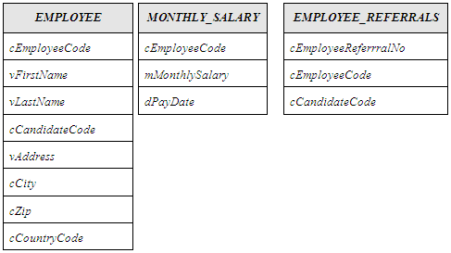
Practice Exercises (Contd.)
Exercise 2:
  Each time the salary slip for an employee is generated, the referral bonus (if present) has to be calculated and printed in the salary slip. The following tables are used for solving the preceding query.
Notes:
You can summarize the session by running through the summary given in SG.
In addition, you can also ask students summarize what they have learnt in this session.

Slide 11
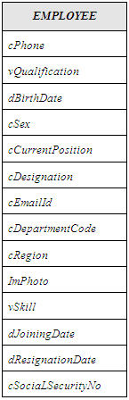
Practice Exercises (Contd.)
  However, the table structures are large, it is necessary to improve the performance of this query by modifying the table structures. Identify how to increase the performance of queries.
Notes:
You can summarize the session by running through the summary given in SG.
In addition, you can also ask students summarize what they have learnt in this session.

Slide 12
Summary
In this session, you learned that:
  The intentional introduction of redundancy in a table in order to improve performance is called denormalization.
  The decision to denormalize results in a compromise between performance and data integrity.
  Denormalization increases disk space utilization.
Notes:
You can summarize the session by running through the summary given in SG.
In addition, you can also ask students summarize what they have learnt in this session.

